Slide 1

GMCC – Celebrity Community Opportunity Mortgage Pilot program – restricted submission
Proprietary & Confidential. For GMCC Mortgage Professionals Only. Distribution is strictly prohibited v5 01-28-2026 ML.

Slide 2
Special
100% financing with no MI; 95% for HB
Available in CA, GA, FL, MA, NC, SC, VA
Can combined with 10k Forgivable loan features (not available in VA/FL)
30 years fixed only, Daily Rate sheet from Lock Desk
Conforming and HB ok
Min borrower contribution = $500; 2 months reserve
Underwriting – based on AUS findings, Max DTI = 45%
Purchase only; OO only
Not limited to first time home buyer (but cannot own any property at closing except subject)
Only available in eligible states and counties
Homebuyer education is required
No limit on IPC’s
This is broker loan

Slide 3
What is Community Opportunity?
A program offered to encourage traditionally underserved applicants the opportunity for homeownership.
Has income, asset and property geographic limits
This program is not for someone that has the money but want to put as little downpayment as they can.

Slide 4
Program Highlights
Primary purchase only, min 80% LTV, up to 100% financing, confirming and HB
No MI
Max liquid asset 36 months of PITI reserves
Min 2 months PITI reserves, min $500 own funds contribution
All income must be disclosed to max income limit eligibility
All buyers on the purchase contract must be borrowers( Removing a buyer is not allowed after loan is submitted)
Non-borrower title holder not allowed
Non-Occupant co-borrower not allowed
Not limited to FTHB
Borrowers cannot hold ownership interest in another proeprty at closing
FTHB require homebuyer education
All loans run FNMA –DU

Slide 5
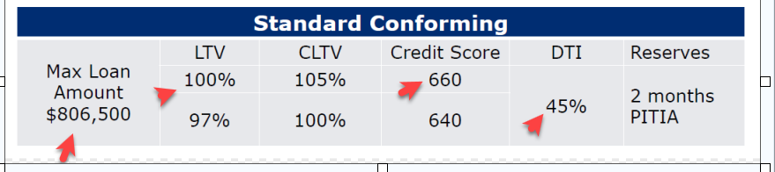
Loan amount/LTV/FICO-Conforming
Manufactured homes are limited to 95% LTV/CLTV in NC, SC, and VA
If borrower lives with a family member:
(1): min credit score is 660 for 97% LTV/100% CLTV or
(2): 680 for 100% LTV/105% CLTV.

Slide 6
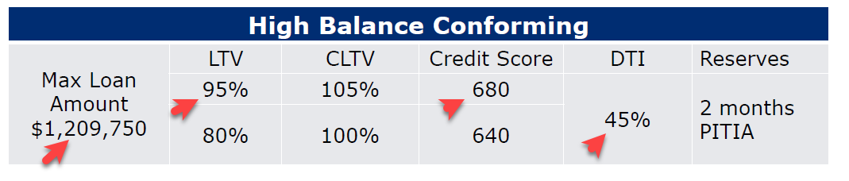
Loan amount/LTV/FICO-HB
Secondary financing (CLTV) is only permitted with community second financing and grants as defined by Fannie Mae.
Manufactured Homes are limited to 95% LTV/CLTV in NC, SC, and VA
Borrower live rent for free: Min score 680 for 80%LTV/100%CLTV

Slide 7
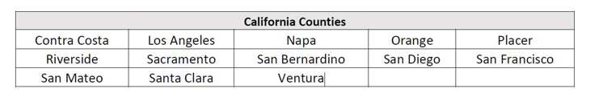

Eligible states and counties
NC – all counties
SC – all counties
CA –
MA -

Slide 8
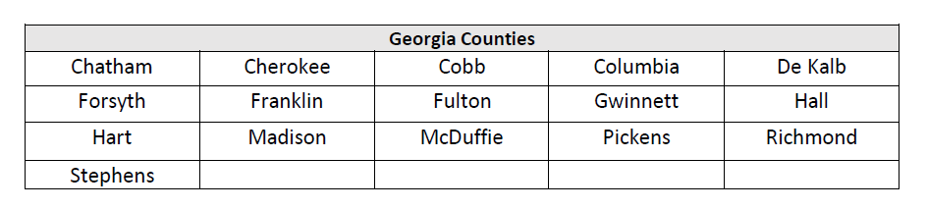
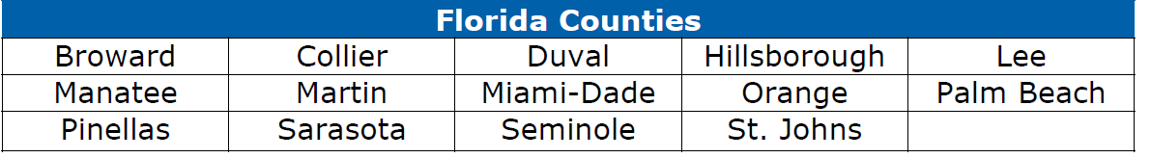
Eligible states and counties
GA /FL
Max income limits for eligible counties in FL:
>100% MFI all qualified properties
>150% MFI for qualified properties and First-Generation Homebuyers

Slide 9
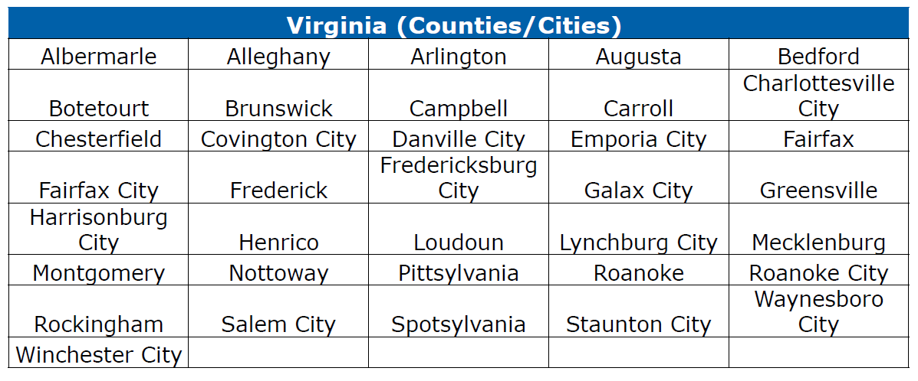
Eligible states and counties
VA –
Max income limits for eligible counties in VA:
>100% MFI all qualified properties
>150% MFI for qualified properties and First-Generation Homebuyers

Slide 10
Income Limits
100% MFI for all properties located in the eligible states and counties
150% MFI for all qualified First-Generation Homebuyers
150% MFI for borrowers moving TO a Majority Minority Census Tract (MMCT) in the allowable areas table.
150% MFI if subject property is located in Low-to-Moderate Census Tracts in the allowable areas, or in MMCT in CA, GA, MA, NC, SC.
200% MFI for First Generation Homebuyers moving TO a Majority Minority Census Tract (MMCT) or to Low-to-Moderate in CA, GA, MA, NC, SC. Refer to allowable areas table.
Allowable areas are NOT the same as eligible areas (mainly VA/FL is not qualified for higher income limit)

Slide 11
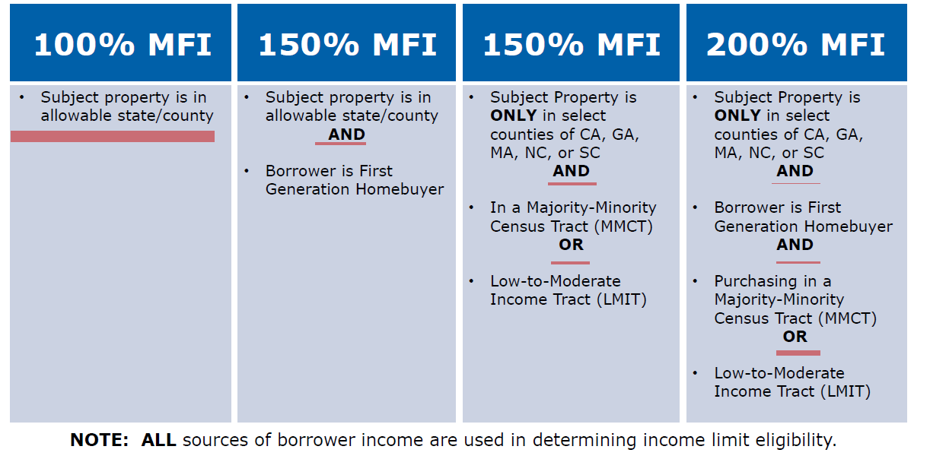
How to determine Income Limits

Slide 12
First Generation Homebuyer
borrower who has not owned a home in the last three years
AND
whose Parent(s) never owned a home
OR
borrower who was in foster care
A borrower who was raised by Guardian(s) meets the definition of a First-Generation homebuyer regardless of Guardian’s property ownership status.
Borrower must complete a FCB First Generation Homebuyer Declaration.

Slide 13
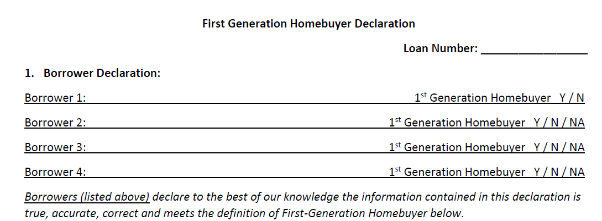
First Generation Homebuyer Declaration

Slide 14
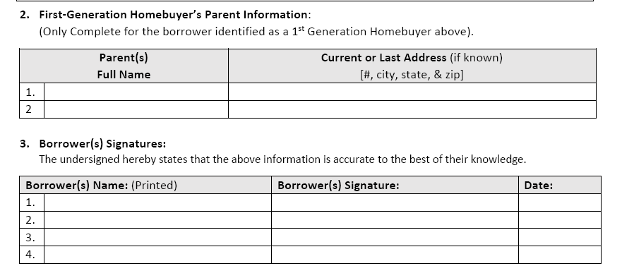
First Generation Homebuyer Declaration

Slide 15
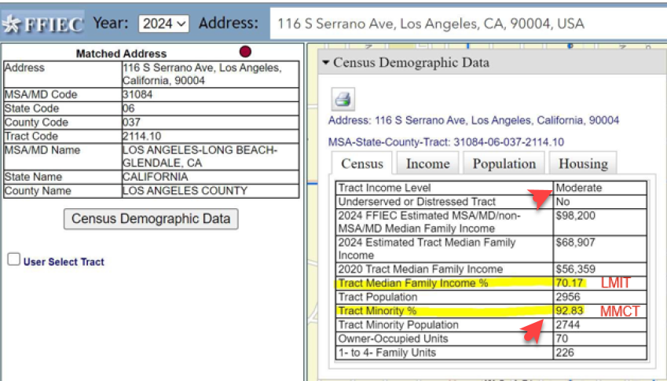
Majority Minority Census Tract (MMCT)
The SUBJECT PROPERTY must be in one of the allowable areas, AND
The borrower must be moving TO an MMCT in one of the allowable areas.
MMCT is defined by a Tract Minority % greater than 50%.
https://geomap.ffiec.gov/ffiecgeomap/

Slide 16
MFI income limit
MFI for the state and county is found on the HUD office of Policy Development and Research Website.
huduser.gov/portal/datasets/il/il2023/select_Geography.odn?STATES=6.0&statelist=6.0&stname=&wherefrom=%24wherefrom%24&statefp=00&year=&ne_flag=0&selection_type=&incpath=%24incpath%24&data=2023

Slide 17
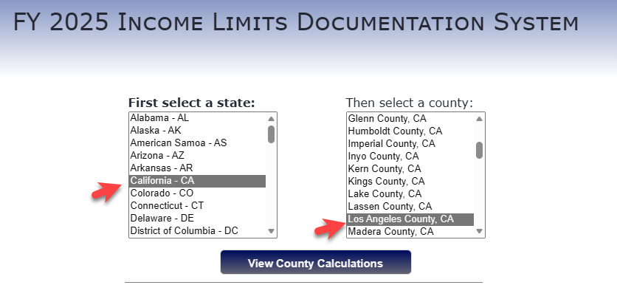
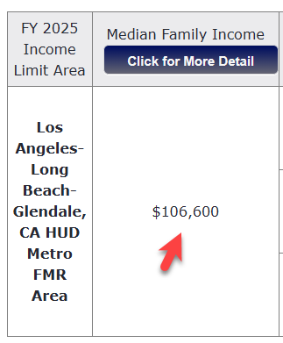
MFI income limit
Income limit
100% = 106,600
150% = 106,600 x 150% =159,900
200% = 106,600 x 200% =213,200
https://www.huduser.gov/portal/satasets/il.html

Slide 18
Majority Minority Census Tract (MMCT)
For Example
Borrower is moving into Los Angeles:
Los Angeles is in LA county in CA = eligible state and county
LA is located at Minority Tract (see FFIEC)
So can use 150% of the MFI income limit (106,600 x 150%)
If First Generation Home Buyer – can use 200% of the MFI income limit (106,600 x 200%)

Slide 19
Credit
2 trade lines open and active for most recent 12 months.
Non-traditional tradelines allowed (i.e., rent, utilities, etc.)
VOR-12 months OK
Credit events:
Foreclosure: – 7 years
Deed-in-Lieu/ Short Sale – 4 year

Slide 20
Income
Need 2 years full-time employment US income history.
2 years W2 and the most recent 30 days paystub with YTD income
Self-employed: need 2 years individual and business tax returns
Schooling can be treated as work history.

Slide 21
Assets
This CRA program is intended for underserved group. It is not intended for borrower with assets but don’t want to put down more downpayment.
If post close asset > 36 months PITIA, then file will not qualify for this CRA program.
Min 2 months PITI reserves
Max gift is 10% of sales price, gift funds can be used as reserves.
Business fund is not allowed
Vested retirement funds: 90%

Slide 22
Notes
Non-arm's length transaction allowed-follow FNMA
Eligible property: SFR(1 Unit), PUD, Warrantable condo
New condo project Ineligible
Manufactured homes in NC, SC, VA ONLY
FLP allowed in CA, GA, MA, NC, SC ONLY
External DPA allowed –Follow FNMA, borrower min own funds $500, max CLTV 105%
No Limit on IPC's

Slide 23
Best Practices
Provide a complete and accurate 1003
If rental history cannot be documented, do not include on 1003
Label income sources correctly to ensure accurate AUS recommendation
No TBD Loans
Provide product checklist for review prior to submitting or locking loan
Reserves must be borrower’s own funds
Follow AUS recommendations
Incomplete submissions will not be moved forward
Partial conditions will not be reviewed
Gift funds must be deposited into Escrow or Borrower account prior to CTC
Need 1 month donor bank statement
Title only person – not allowed

Slide 24
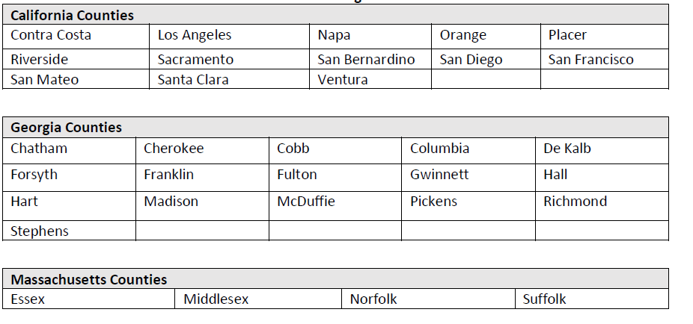
Allowable areas for increased income limit-CA/GA/MA
150% or 200% MFI income limits available for allowable counties in CA, GA, MA, NC, SC.

Slide 25
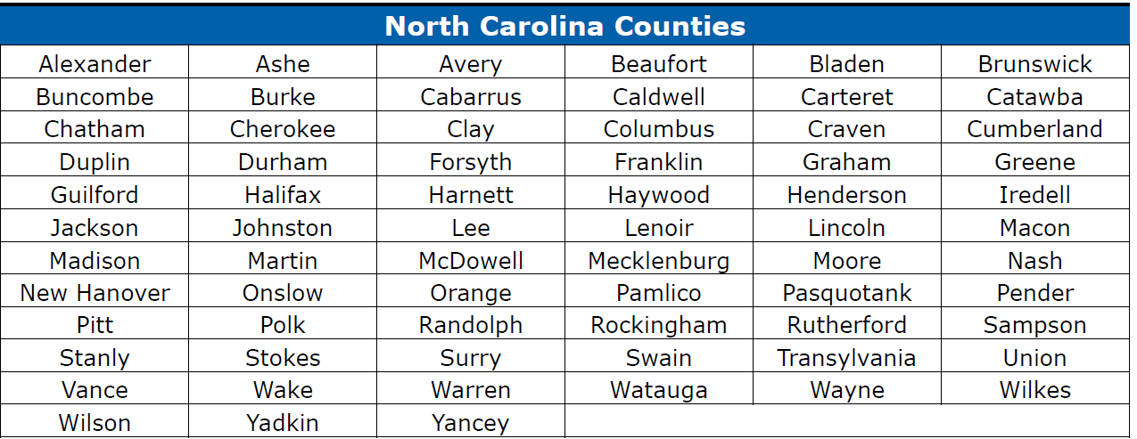
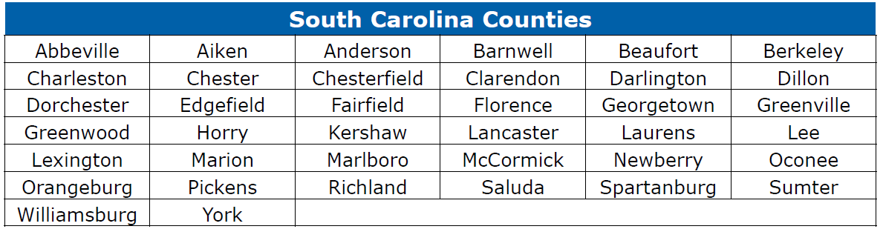
Allowable areas for increased income limit-NC/ SC

